Slide 1






SEGMENTATION
ANALYSIS

Slide 2





TODAY’S AGENDA
HOW OUR DOMAIN WORKS
We will begin by examining the current state of political prediction models, identifying their key challenges such as limited real-time insights, outdated polling methods, and potential data biases. By doing this, we can uncover gaps that our model is specifically designed to address.
Next, we’ll outline how our model differs from existing approaches and highlight its unique features.
We will analyze the key stakeholders who will benefit from our model and discuss our implementation timeline.
We will also explore the anticipated impact of our model on political forecasting, demonstrating how it can improve accuracy, provide faster insights, and offer deeper predictive power compared to traditional methods.
Finally, we will explore the anticipated impact of our model on political forecasting

Slide 3




Problems we are addressing
Existing models lack real-time adaptability to voter shifts and regional nuances.
Traditional predictions are too broad, missing detailed, actionable data for campaigns and media.
Most models ignore economic implications of political outcomes, limiting strategic foresight.

Slide 4




Our Target Consumers
Provide insights on voter behavior, regional dynamics and real-time reactions to optimize messaging and resource allocation
Enable data-driven reporting with clear predictions and context, supporting balanced, real-time election coverage.
Political campaignist and Strategists
Offer in-depth data and behavioral insights to explore political theories, policy impacts, and social trends.
Provide economic indicators and scenario analysis to assess market and sector-specific impacts of potential political outcomes.

Slide 5




Improved Predictive Accuracy
Our model enhances accuracy by integrating real-time event tracking, sentiment analysis, and detailed regional data to capture nuanced voter shifts.
How is our solution different
Actionable Insights
We deliver targeted, demographic-specific information, enabling campaigns and media to make informed decisions based on precise data.
Clear Uncertainty Modeling
Using advanced techniques, our model effectively communicates prediction confidence and potential variations, fostering trust in the outcomes.
Economic and Policy Impact Integration
By projecting policy and market impacts, our solution provides strategic foresight that supports decision-making across various sectors.

Slide 6


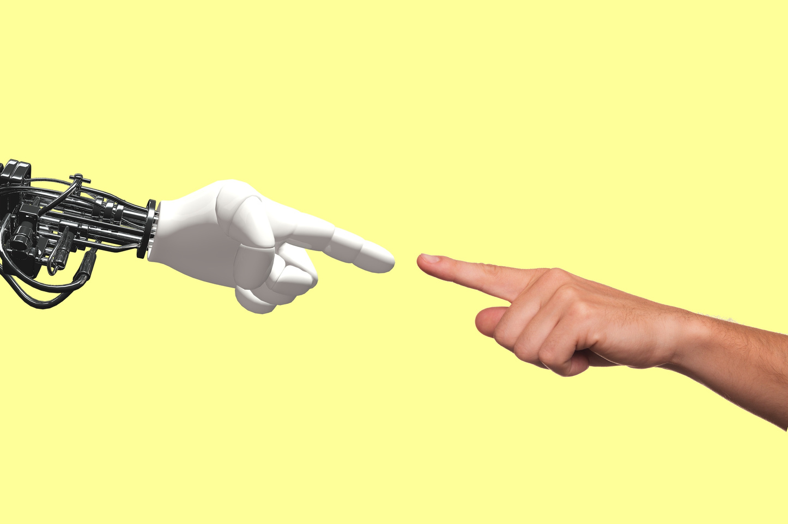
What dataset are we working on?
Api Calls from Reddit and Twitter
Web scrapping from famous news channels
Back to Agenda

Slide 7


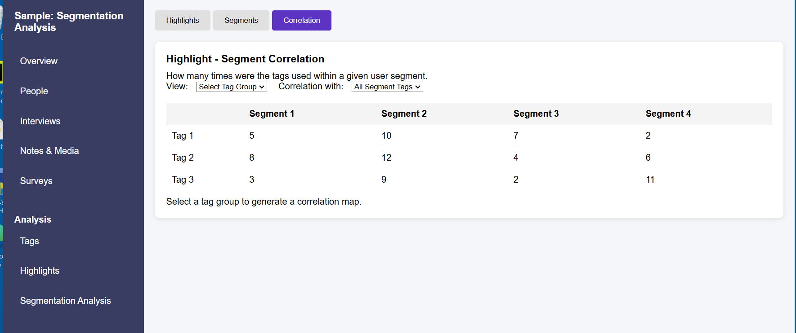
Wireframe example

Slide 8

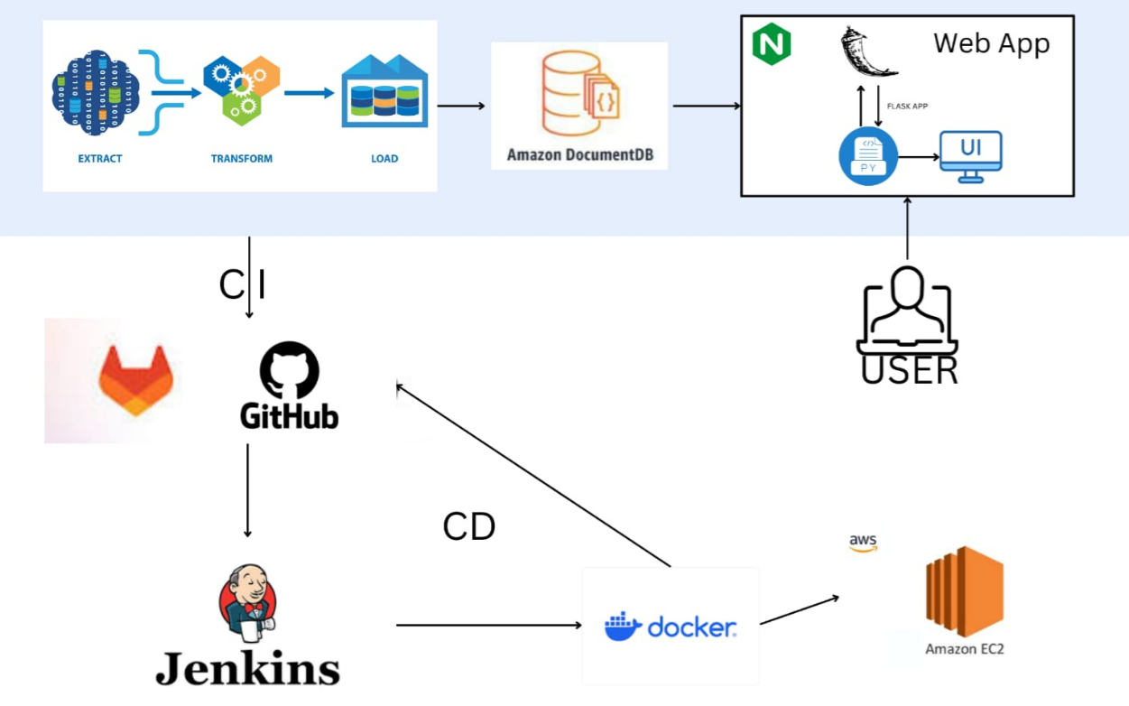
Our initial workflow diagram

Slide 9







Thank you
Krunal Patel C0936008
Gustavo Andres Vera Suarez C0917164
Yorbis Daniel Alarcon C0941168
Sangsun Lee C0905412
Komal Nandal C0938518
Sneha Painuli C0933116
Mahek Ghanchi C0937254
Hazel Santos C0915982
@reallygreatsite

